Slide 1
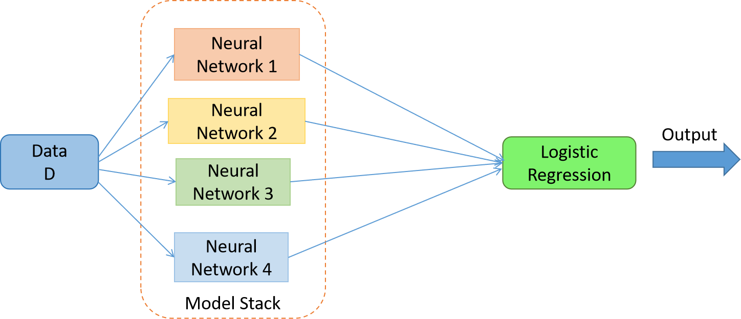
Stacking
Stacking (short for stacked generalization) is an ensemble learning technique where you combine predictions from multiple different models using another model (called a meta-learner).

Slide 2
Key Points about Stacking:
Base models (Level-0): You train several different models (e.g., Random Forest, XGBoost, SVM, etc.).
Meta-model (Level-1): Another model (often Logistic Regression) takes the predictions of the base models as inputs and learns how to best combine them.
Goal: Exploit the strengths of multiple models and reduce their weaknesses.

Slide 3
Difference from other ensembles
Bagging → trains many models of the same type on random subsets of data, then averages/votes.
Boosting → trains models sequentially, each one fixing the errors of the previous.
Stacking → trains diverse models in parallel and then uses a meta-model to blend their outputs.

Slide 4
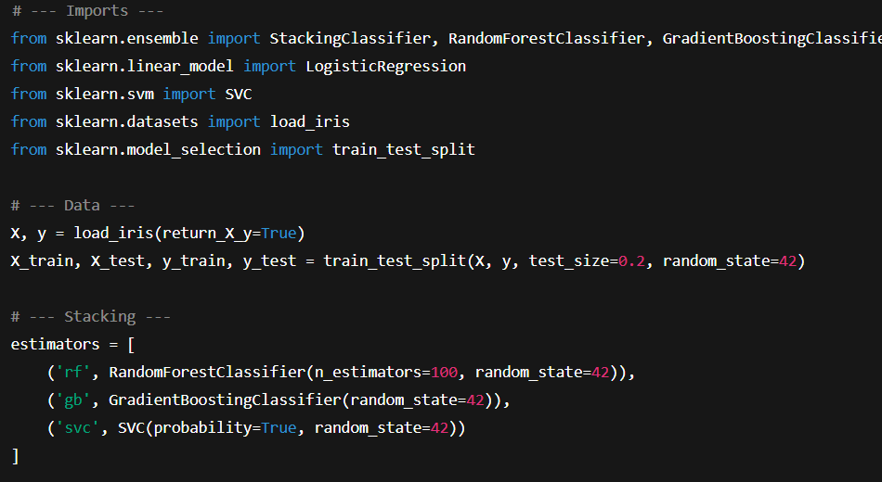
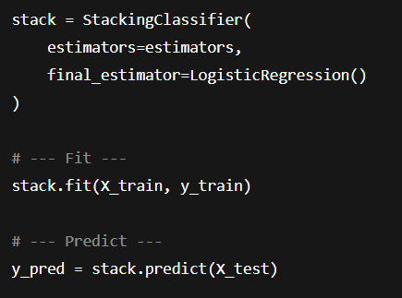
Code Implementation

